Slide 1

AquaDetect Disease Detection In AquaCulture

Slide 2
Index
Problem Statement
Introduction
Motivation
Objective
Literature Review
Methodology
Requirements
Flow Chart
Implementation
References

Slide 3
Problem Statement
Bacterial Red disease, Bacterial gill disease are two of the popular diseases which caused a high mortality rate for fish which occurred in many countries. Implement a model to detect such diseases.

Slide 4
Introduction
Detecting infected fish early is crucial but challenging due to limited infrastructure. Combining image processing techniques with machine learning algorithms can indeed be used to identify infected fish, enabling the implementation of preventative and corrective measures. The process involves image pre-processing, segmentation, and disease classification using Support Vector Machine (SVM) algorithm.

Slide 5
Motivation
Why take up this topic? Why is this found challenging to you?
The topic of "Fish Disease Detection Using Image-Based Machine Learning Techniques in Aquaculture" was chosen for presentation due to its significant implications for food security and the aquaculture industry. With the global expansion of aquaculture, the threat of fish diseases poses a challenge to sustainable production. Leveraging image processing and machine learning methods offers a promising approach to early detection and mitigation of these diseases, thus safeguarding both economic interests and food supply chains.

Slide 6
Objectives
Implement Support Vector Machine (SVM) algorithm for fish disease classification.
Assess model performance metrics including accuracy, precision, recall, and F1 score .
Achieving highest possible accuracy in disease detection.
Explore real-time implementation feasibility in aquaculture facilities.

Slide 7
LITERATURE SURVEY
SL Number | Paper Title, Author, Year of Publication | Abstract , Technique mentioned | Limitations
1. | EPIZOOTIC ULCERATIVE SYNDROME (EUS) FISH DISEASE CHRONOLOGY, STATUS AND MAJOR OUTBREAKS IN THE WORLD, Devashish Kar and Roy Aurobindo, 2021 | Epizootic Ulcerative Syndrome (EUS) has caused significant mortality among freshwater fish globally since the 1970s. The disease manifests as large hemorrhagic cutaneous ulcers, epidermal degeneration, and necrosis, ultimately leading to the shedding of scales. To prepare a working hypothesis, Intensive follow up, Management of epidemiologic episodes, delved into various aspects of EUS, including limnological, physical, chemical, bacteriological, fungal, and viral investigations | Does not provide detailed Analysis on the India prospect on disease, environmental factors and region-based patterns

Slide 8
LITERATURE SURVEY
SL Number | Paper Title, Author, Year of Publication | Abstract , Technique mentioned | Limitations
2. | An overview on epizootic ulcerative syndrome of fishes in India: A comprehensive report, Nilesh Kumar Pagrut, Subha Ganguly, Vikas Jaiswal and Chandrapratap Singh, 2017 | Epizootic Ulcerative Syndrome (EUS) in India affects various fish genera, with Channa and Puntius being most impacted. Prevalence rates vary, and Aeromonas hydrophila and Saprolegnia are implicated. Different techniques used to get cause and patterns are Environmental Factors, Suspected Mostly Important Causative Factors of EUS Heavy metal in water, Agrochemicals and Pesticide, Virus, Bacteria | Lacks the management and prevention of EUS and provides only causation of phenomenon

Slide 9
LITERATURE SURVEY
SL Number | Paper Title, Author, Year of Publication | Abstract , Technique mentioned | Limitations
3. | A Comprehensive Overview of Fish Disease Detection Using Image Based Machine Learning Technique in Aquaculture, By Md Shoaib Ahmed, Tanjim Taharat Aurpa, Md. Abul Kalam Azad 2021 | discusses a framework for classifying salmon fish diseases using various technologies and techniques such as extended Cubic Splines interpolation, Adaptive Histogram Equalization, k-means clustering segmentation, and Support Vector Machine (SVM). Performance evaluation metrics such as Accuracy, Precision, Recall, Specificity, F1 score, and various rates like False Positive Rate (FPR), False Negative Rate (FNR), and True Positive Rate (TPR) are calculated. | Limited Dataset Size, focused on SVM classifier, possible overfitting/underfitting, low parameter tuning

Slide 10
LITERATURE SURVEY
SL Number | Paper Title, Author, Year of Publication | Abstract , Technique mentioned | Limitations
4. | An in-depth automated approach for fish disease recognition By Md. Jueal Mia, Rafat Bin Mahmud, Md. Safein Sadad | The article mentions the utilization of eight prominent classification algorithms for fish disease recognition. While Random Forest performed the best, the study also evaluated several other algorithms such as Logistic Regression, Neural Networks, Gradient Boosting, Support Vector Machine, K-Star, and K-Nearest Neighbors. These algorithms might have shown varying levels of accuracy and effectiveness in classifying fish diseases. | Limitations may include dataset size, quality, feature selection, model evaluation, real-world deployment challenges, and interpretability issues in machine learning-based fish disease recognition systems.

Slide 11
LITERATURE SURVEY
SL Number | Paper Title, Author, Year of Publication | Abstract , Technique mentioned | Limitations
5. | Epizootic ulcerative syndrome causes cutaneous dysbacteriosis in hybrid snakehead Channa maculate, Channa argus Jun Xie, Deguang Yu 2019 | Aphanomyces infection causes epizootic ulcerative syndrome (EUS) in fish, and by perturbing the integrity of the cutaneous microbiota, increases the potential for infection by pathogenic bacteria. Cutaneous microbiota play an important role in protecting fish against pathogens whether the composition of the cutaneous microbiota is altered in fish with EUS, and if so, which species are changed and how this might influence infected fish, is still largely unclear. | Limitations includes a focused study on only hybrid snakehead

Slide 12
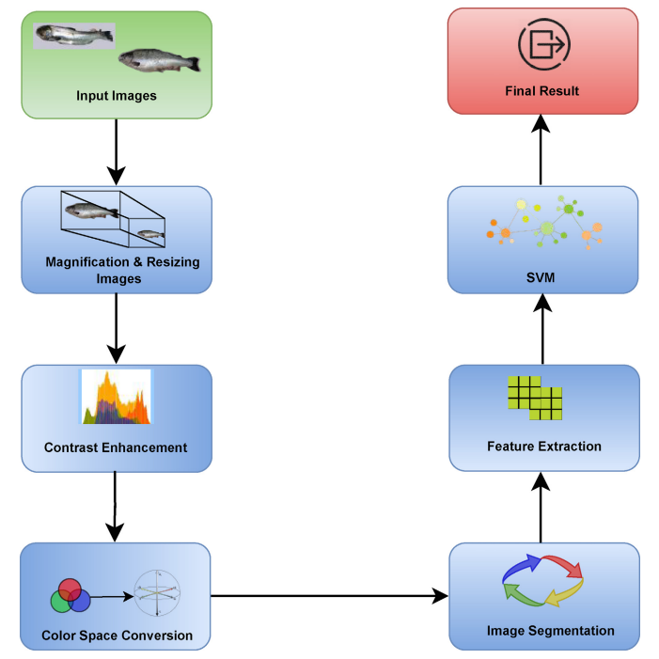
Methodology

Slide 13
Requirements:
Hardware Requirements:
GPU
8GB Ram
64bit Operating System x64-based processor
Desktop/Laptop
Software Requirements:
Python 3
pandas , os, scikit-image, scikit-learn, numpy, Matplotlib, joblib
Jupyter Notebook
Machine Learning scikit libraries
Fish Disease Freshwater Dataset

Slide 14
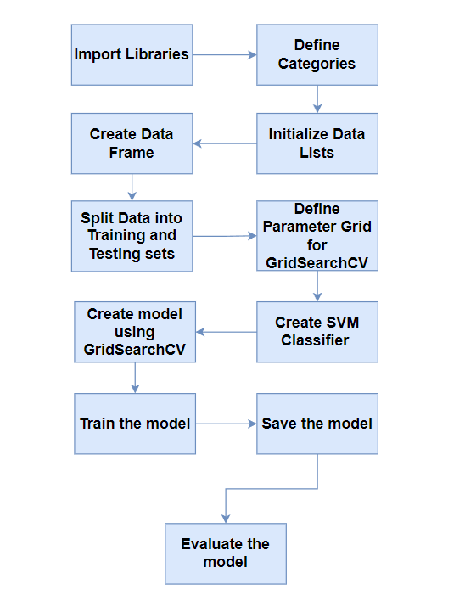
Flow chart

Slide 15
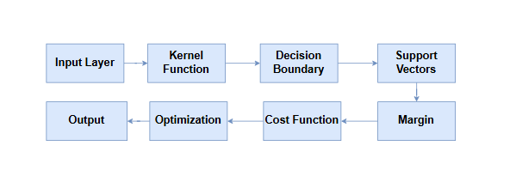
Support Vector Machines (SVMs) are a type of supervised learning model used for classification and regression tasks.
SVMs take input data consisting of features. Each feature represents a different characteristic or attribute of the data point being classified.
SVMs use a kernel function to transform the input data into a higher-dimensional space where it can be linearly separated.
Support Vectors: Support vectors are the data points that lie closest to the decision boundary. They are crucial for determining the decision boundary and defining the margin.
Cost Function: SVMs use a cost function to penalize misclassifications. The cost function balances between maximizing the margin and minimizing classification errors.
Output: Once trained, SVMs can classify new data points by determining which side of the decision boundary they lie on.

Slide 16
Implementation:
Data collection :
Fish Disease Freshwater data set from Kaggle.
Algorithm:
Loading the dataset.
Visualizing the data distribution
Defined parameters for training data such as early stopping , learning rate reduce to prevent computational over head.
Loaded SVM from saved Model, which is trained on huge dataset such as image net.

Slide 17
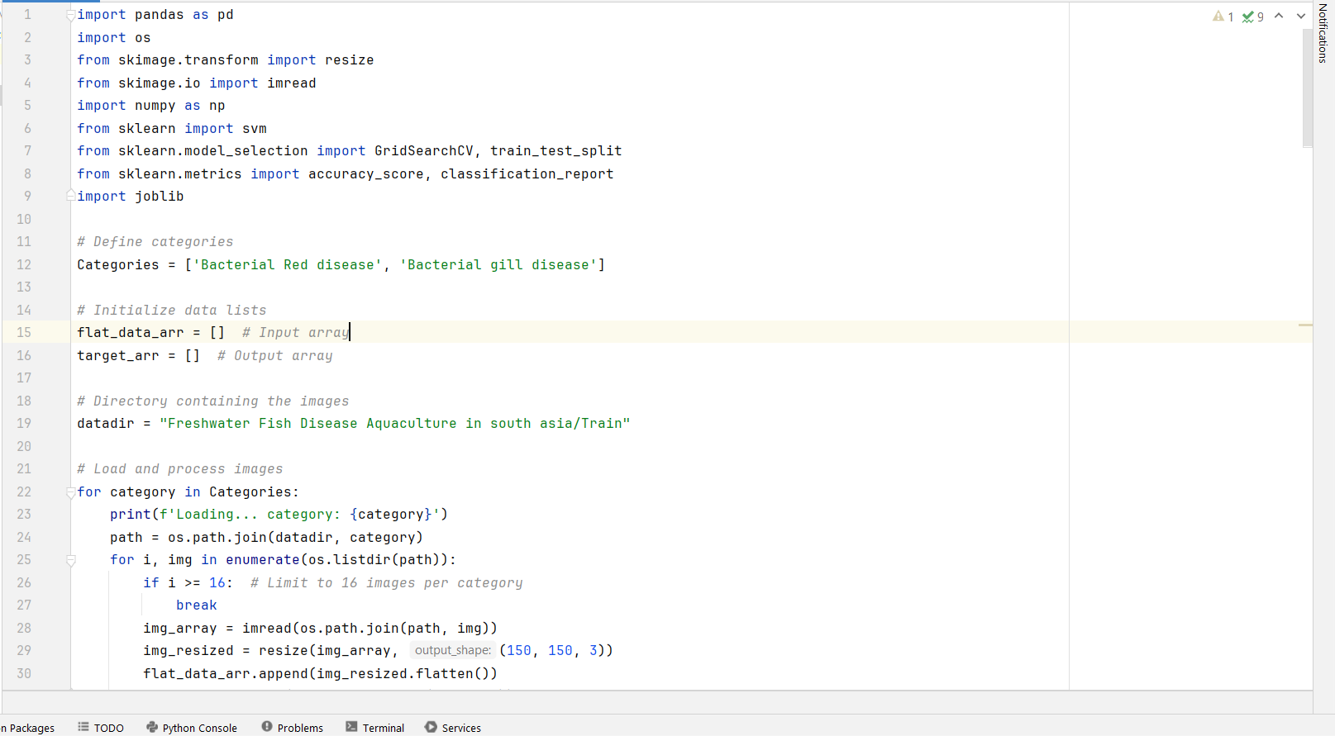
Code images :

Slide 18
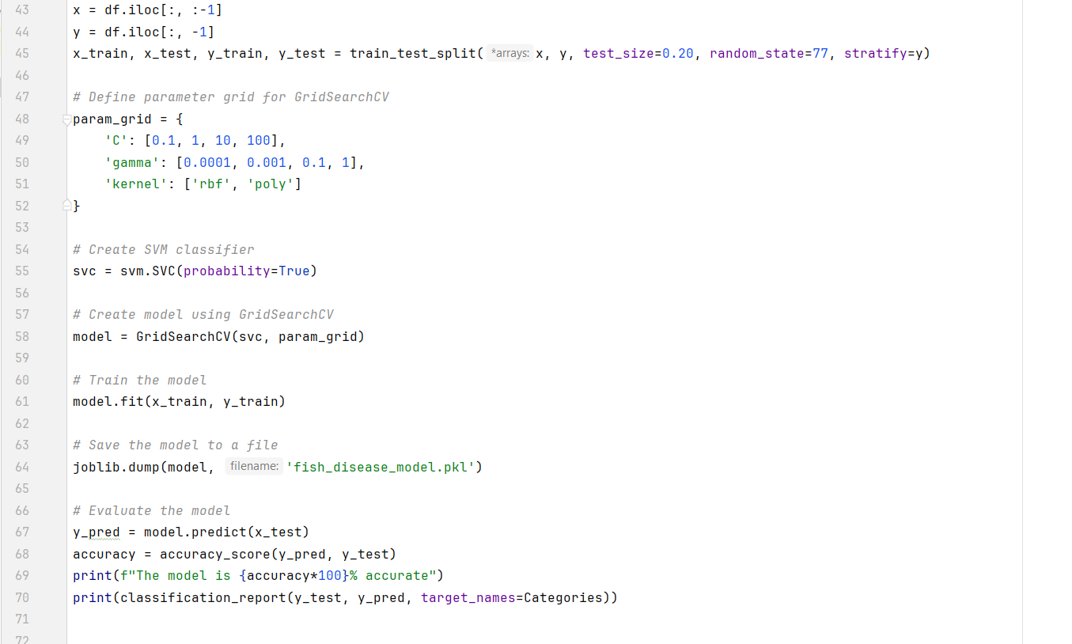
Code images :

Slide 19
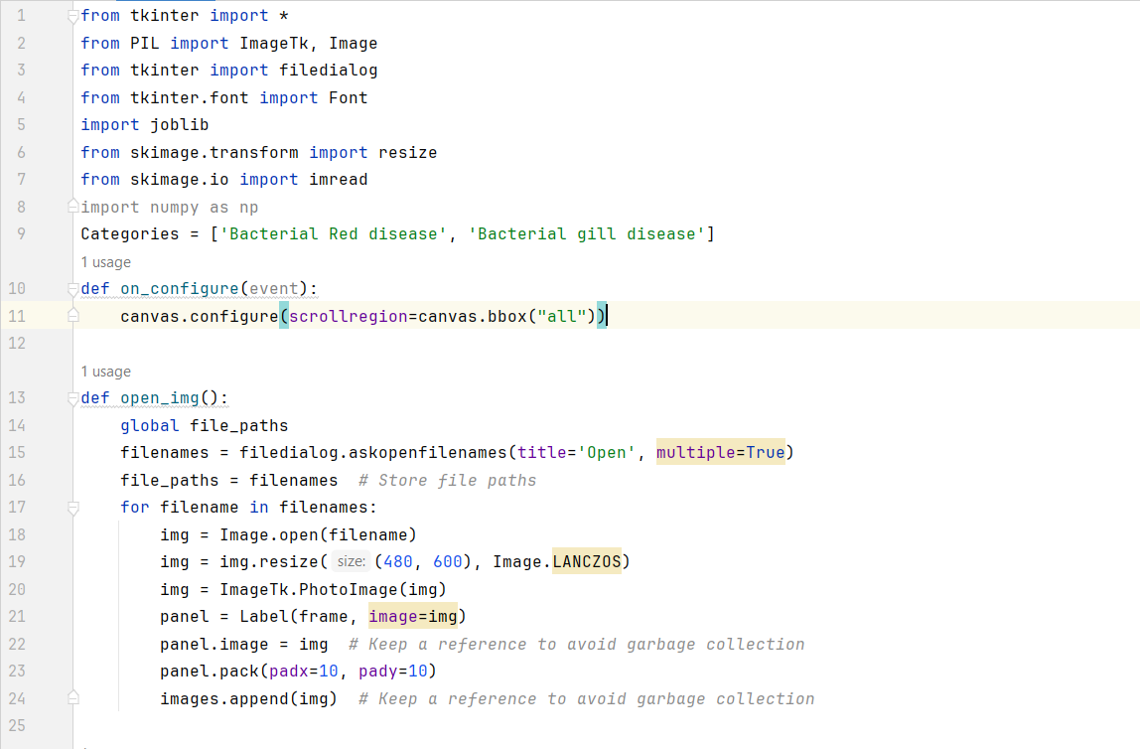
Code images :

Slide 20
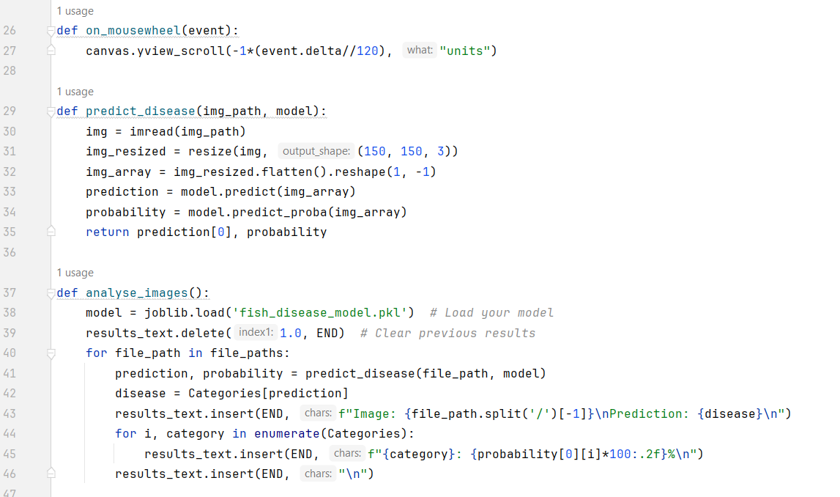
Code images :

Slide 21
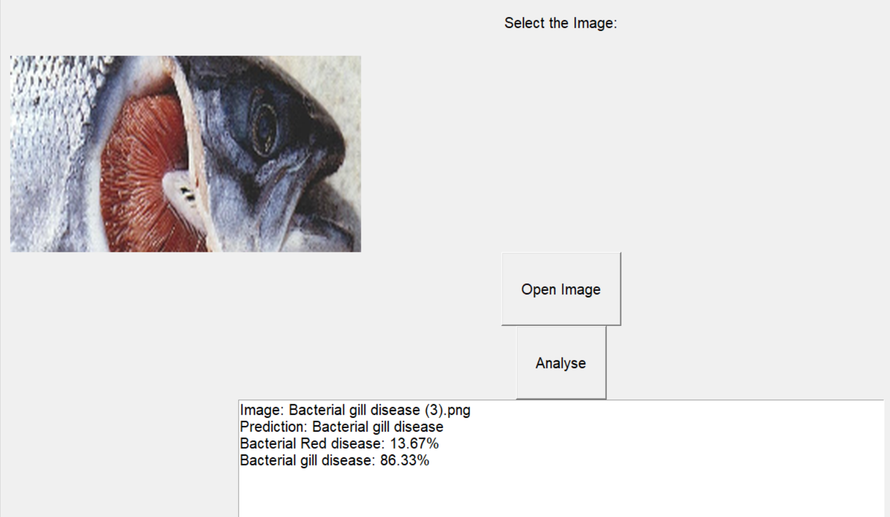
Code images :

Slide 22
//Kaggle predction and accuracy

Slide 23
MODEL TESTING
Image Upload: An image is uploaded to the model.
Model Prediction: The model predicts the disease type based on the uploaded image.
Printing Predicted Disease: The predicted disease type is printed.

Slide 24
REFERENCES
Devashish Kar and Roy Aurobindo, “EPIZOOTIC ULCERATIVE SYNDROME (EUS) FISH DISEASE CHRONOLOGY, STATUS AND MAJOR OUTBREAKS IN THE WORLD”, Transylvanian Review of Systematical and Ecological Research 23(2):29-38, July 2021
Nilesh kumar Pagrut, Subha Ganguly, Vikas Jaiswal and Chandrapratap Singh, “An overview on epizootic ulcerative syndrome of fishes in India: a comprehensive report”, JOURNAL OF ENTOMOLOGY AND ZOOLOGY STUDIES 5(06):1941-1943, December 2017
A Comprehensive Overview of Fish Disease Detection Using Image Based Machine Learning Technique in Aquaculture, By Md Shoaib Ahmed, Tanjim Taharat Aurpa, Md. Abul Kalam Azad 2021
An in-depth automated approach for fish disease recognition By Md. Jueal Mia, Rafat Bin Mahmud, Md. Safein Sadad
Epizootic ulcerative syndrome causes cutaneous dysbacteriosis in hybrid snakehead Channa maculate, Channa argus Jun Xie, Deguang Yu 2019

